Slide 1
Boosting Regression Algorithms in Machine Learning
A Deep Dive with Real-World Examples
Marudha Nayagam M
AI Engineer

Slide 2
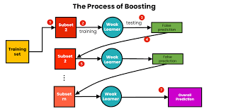
Introduction to Boosting Regression
What is Boosting in Regression?
Boosting is an ensemble technique that combines multiple weak learners to form a strong learner to improve overall predictive accuracy by focusing on minimizing errors.
Key Points to Remember
Boosting is about combining multiple simple models (weak learners) to create a strong overall model.
Weak learners are models that are not very powerful on their own but can be improved by focusing on their mistakes.
Sequential Learning Process: Models are trained one after another, with each new model focusing on correcting the mistakes of the previous models.
Error Focus: Emphasis on misclassified data points by assigning them higher weights for the next model.
Final Model: Combines all weak learners to make a stronger and more accurate prediction.

Slide 3

How Boosting Works
First Model: catch some obvious spam emails, like those with suspicious keywords ("win money," "free gift"), but it misses more subtle ones
Second Model: focuses on the first model missed—maybe it looks for certain phrases or sender information that the first model didn’t catch.
Third Model: The third model looks at even trickier spam emails, such as those with attachments or certain formatting tricks.
Each model improves on the last by catching different types of spam
Real-Time Example: Spam Email Detection

Slide 4
Types of Boosting Regression Algorithms
AdaBoost Regression (Adaptive Boosting)
XGBoost (Extreme Gradient Boosting)
LightGBM (Light Gradient Boosting Machine)

Slide 5
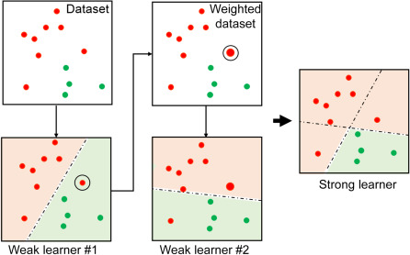
AdaBoost Regression
What is AdaBoost?
AdaBoost Regression adapts by assigning weights to data points with larger errors, focusing more on difficult-to-predict cases

Slide 6
AdaBoost Regression
Strengths:
Simple and effective, particularly useful for reducing bias.
Weaknesses:
Sensitive to outliers and noisy data, which can lead to overfitting.
Applications:
Financial forecasting
Sales prediction
Other regression tasks requiring robust error reduction.
Real-World Example:
Predicting car prices: AdaBoost Regression improves prediction accuracy by focusing on cars with unusual features.
How It Works:
Starts with equal weights, and with each iteration, misclassified points get higher weights.
Models are combined by weighted majority voting.

Slide 7
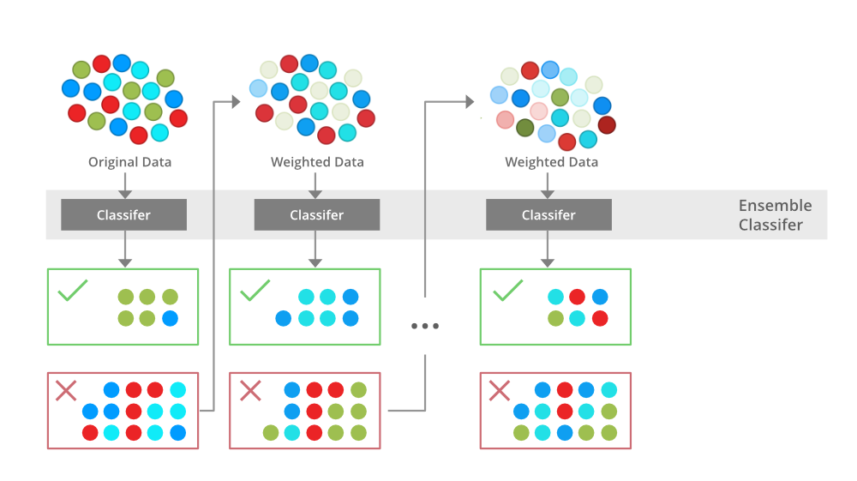
XGBoost Regression
What is XGBoost Regression?
XGBoost is an advanced boosting algorithm that is highly optimized for speed and accuracy in regression tasks.
XGBoost is an implementation of gradient-boosting decision trees.

Slide 8
XGBoost Regression
Real-World Example:
Predicting stock prices: XGBoost efficiently models complex patterns in financial data to forecast stock trends.
How It Works:
Uses gradient boosting with regularization to reduce overfitting and enhance model performance.
Incorporates tree pruning, weighted quantile sketch, and parallel processing for fast computation.
Strengths:
Highly accurate and scalable, suitable for large datasets with complex patterns.
Weaknesses:
Complex and requires significant computational resources; can be challenging to tune.
Applications:
Financial modeling
Time series forecasting
large-scale regression problems in various industries.

Slide 9
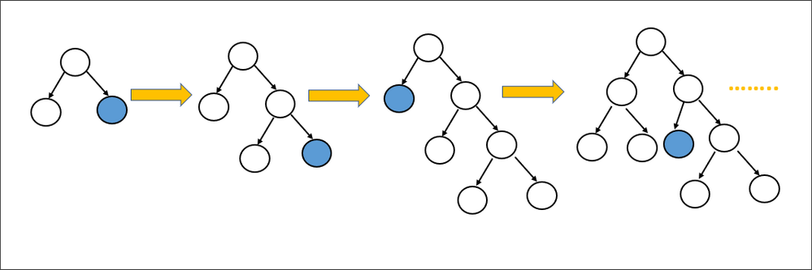
LightGBM Regression
What is LightGBM Regression?
LightGBM is a fast and efficient gradient boosting framework that excels in regression tasks with large datasets that uses decision tree algorithms..

Slide 10
LightGBM Regression
Real-World Example:
Predicting energy consumption: LightGBM quickly processes large amounts of data to predict future energy needs.
How It Works:
Leaf-Wise Tree Growth: Grows trees based on the largest loss reduction, leading to better accuracy.
Histogram-Based Binning: Speeds up training by grouping data points into bins, reducing computation.
Strengths:
Extremely fast and efficient, particularly with large datasets.
Handles high-dimensional data and supports parallel and GPU processing.
Weaknesses:
Can overfit small datasets; requires careful tuning.
Applications:
Large-scale regression tasks in energy forecasting
Market demand prediction
Customer lifetime value estimation.

Slide 11
Summary of Boosting Regression Algorithms
Key Takeaways:
Boosting regression algorithms improve prediction accuracy by focusing on reducing residuals.
Different algorithms (AdaBoost, LightGBM, XGBoost) offer unique strengths and are suitable for different types of regression tasks.
Proper tuning and understanding of data characteristics are essential for leveraging these algorithms effectively.

